Slide 1

Ques. 1
Average lead time is very less.

Slide 2
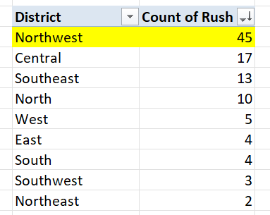
Ques. 2
Northwest has highest number of rush jobs.

Slide 3
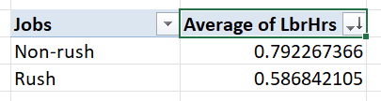
Ques. 3
Average labour hours in non-rush jobs is higher than rush jobs by 0.2 hours.

Slide 4
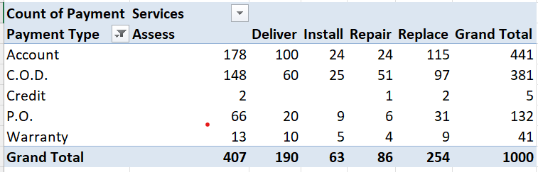
Ques. 4
This is the distribution of payment types across different services, with account payment having the most usage across all services.

Slide 5
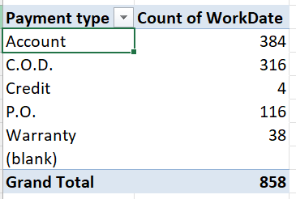
Ques. 5
This is the trend over the years.

Slide 6
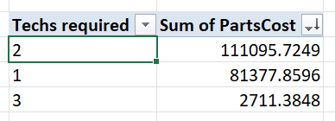
Ques. 6
Wherever 3 techs are required the parts cost decreases significantly.

Slide 7
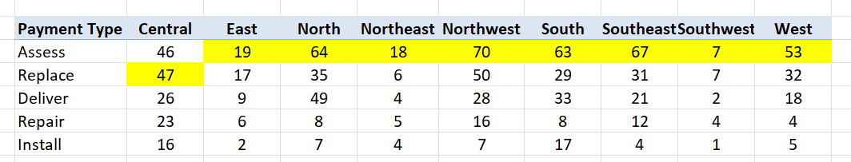
Ques. 7
These are the most common services in each district.

Slide 8
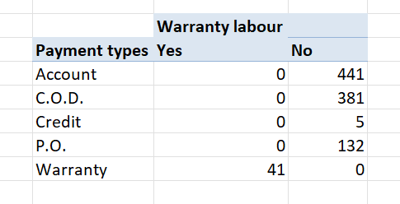
Ques. 8
All the warranty labours choose the warranty type payment method.

Slide 9
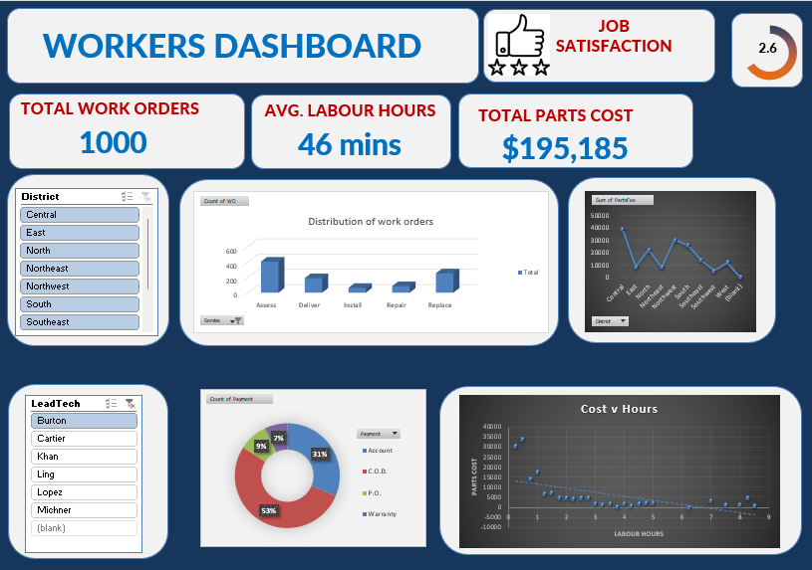
Ques. 9

